Slide 1
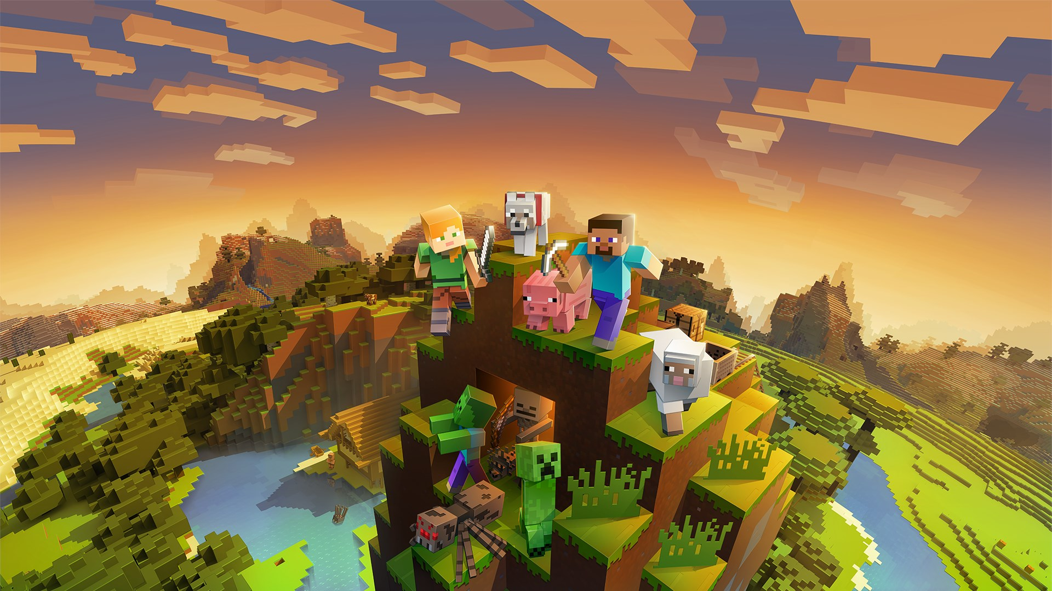

Minecraft 2: The Next Evolution in Sandbox Gaming
Revolutionizing Creativity and Exploration
Presented by :
Jean-Baptiste GOSSOT, Lead Game Designer
An Project
B-ENG-200

Slide 2
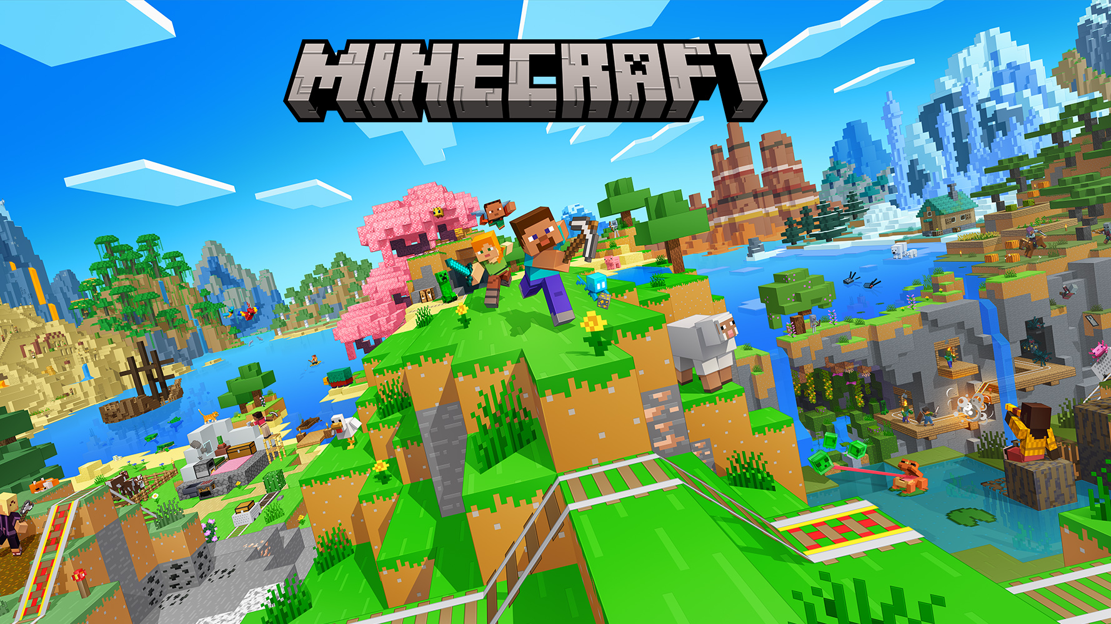

Minecraft 2 or the sequel to the best-selling game
Goal :
Elevating the gameplay
Elevating the technology
Elevating the creativity
Revolutionize the sandbox genre
Presented by :
Jean-Baptiste GOSSOT, Lead Game Designer
An Project
B-ENG-200

Slide 3
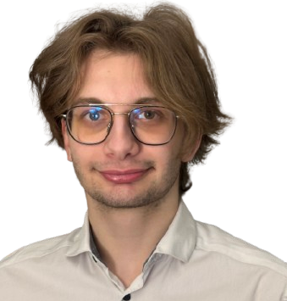
Our teams, who are we ?
Jean-Baptiste GOSSOT,
Lead Game Designer
Role : Expert in procedural generation and AI-driven world-building
Particularity : Doesn’t know how to code anything
Presented by :
Jean-Baptiste GOSSOT, Lead Game Designer
An Project
B-ENG-200

Slide 4
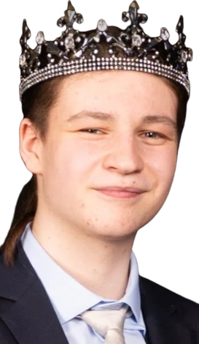
Our teams, who are we ?
Nathan CLAUDEL,
Art Director
Role :Enhancing Minecraft’s iconic aesthetic
Particularity : He’s the King (Bichat 2024)
Presented by :
Jean-Baptiste GOSSOT, Lead Game Designer
An Project
B-ENG-200

Slide 5
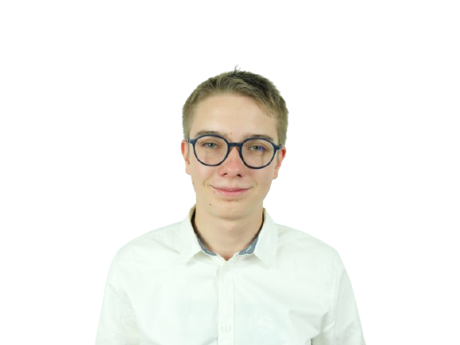
Our teams, who are we ?
Victor JOST,
AI & NPC Designer
Role : Create advanced behaviors for mobs and villagers
Particularity : Works while being on his phone
Presented by :
Jean-Baptiste GOSSOT, Lead Game Designer
An Project
B-ENG-200

Slide 6
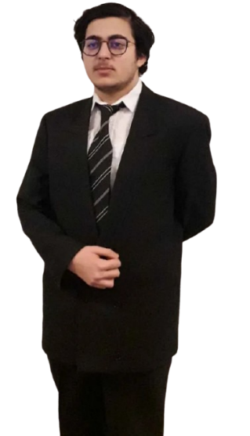
Our teams, who are we ?
David TETIK,
Game Economy Specialist
Role : Create balanced trade system with villagers
Particularity : Capitalist man
Presented by :
Jean-Baptiste GOSSOT, Lead Game Designer
An Project
B-ENG-200

Slide 7
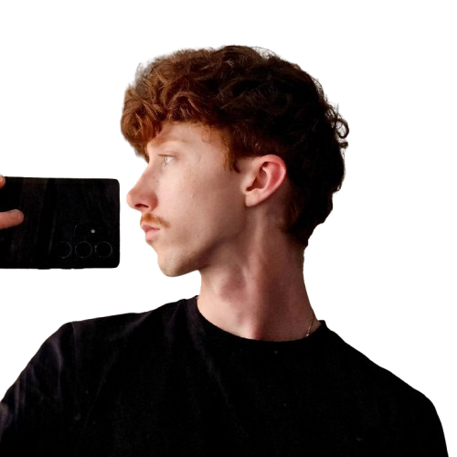
Our teams, who are we ?
Noham JACQUOT
Marketing & Community Manager
Role : Engaging with the Minecraft fanbase
Particularity : Doesn’t know to take a selfie
Presented by :
Jean-Baptiste GOSSOT, Lead Game Designer
An Project
B-ENG-200

Slide 8
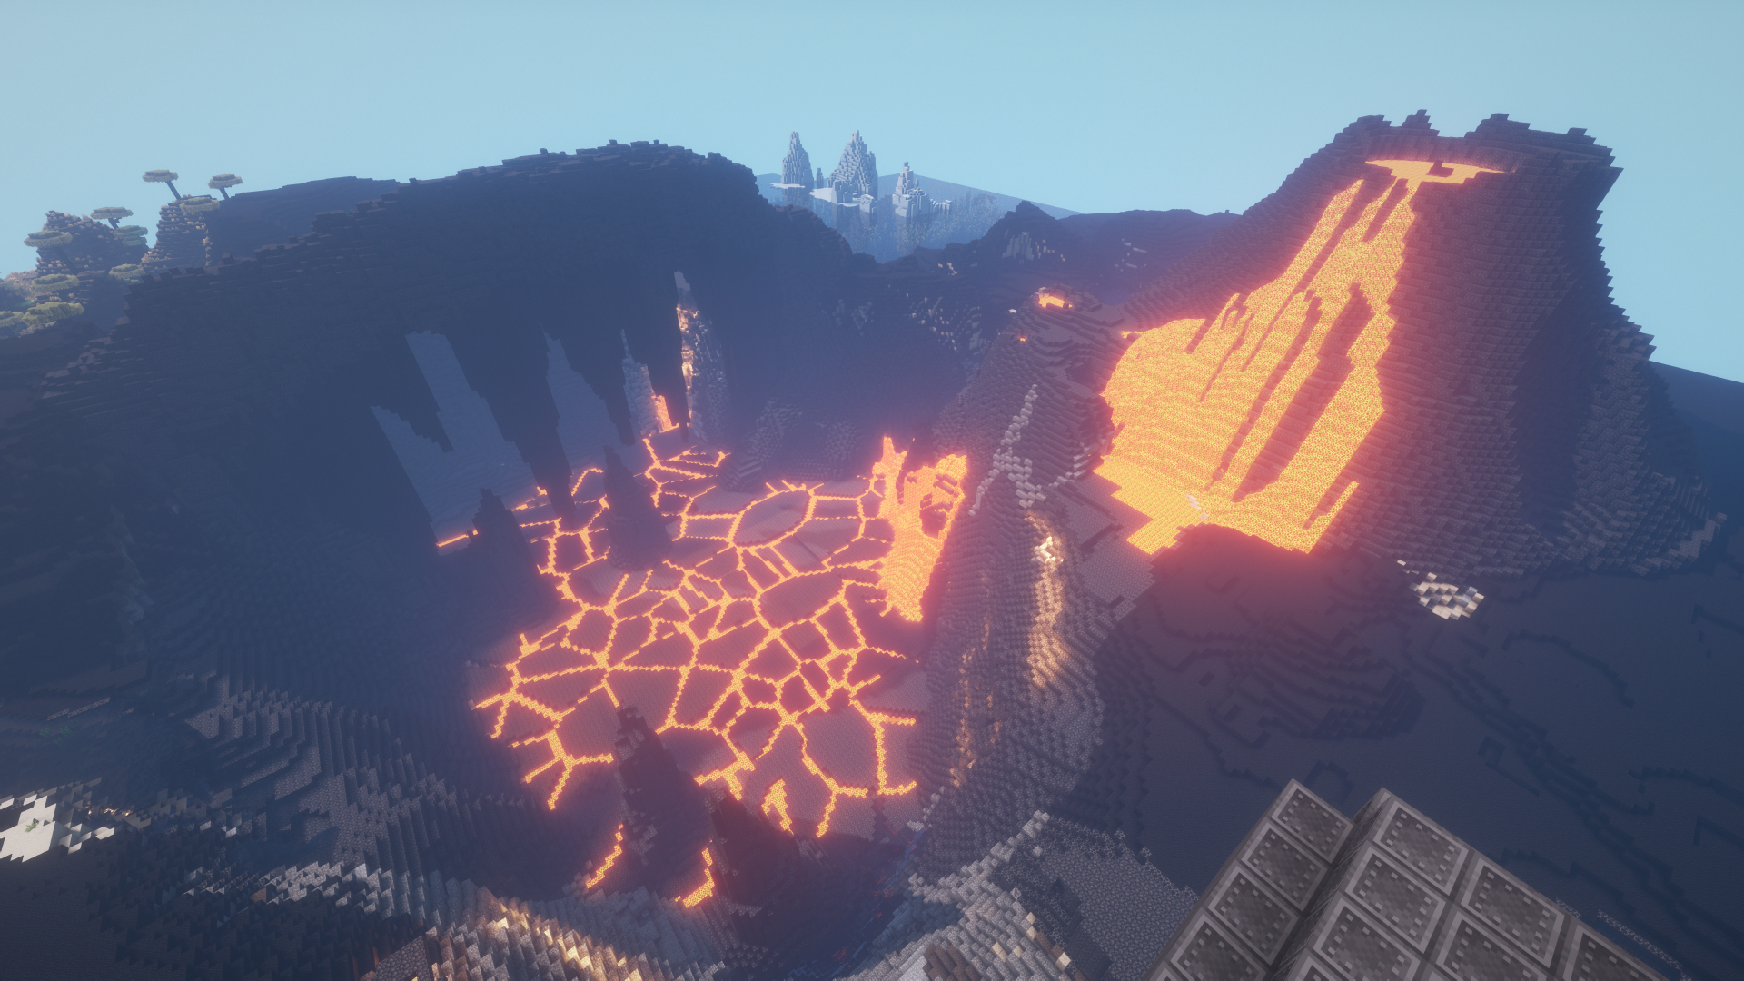
Volcanic Biome
New Biome & Enhanced Graphism
Presented by :
Jean-Baptiste GOSSOT, Lead Game Designer
An Project
B-ENG-200

Slide 9
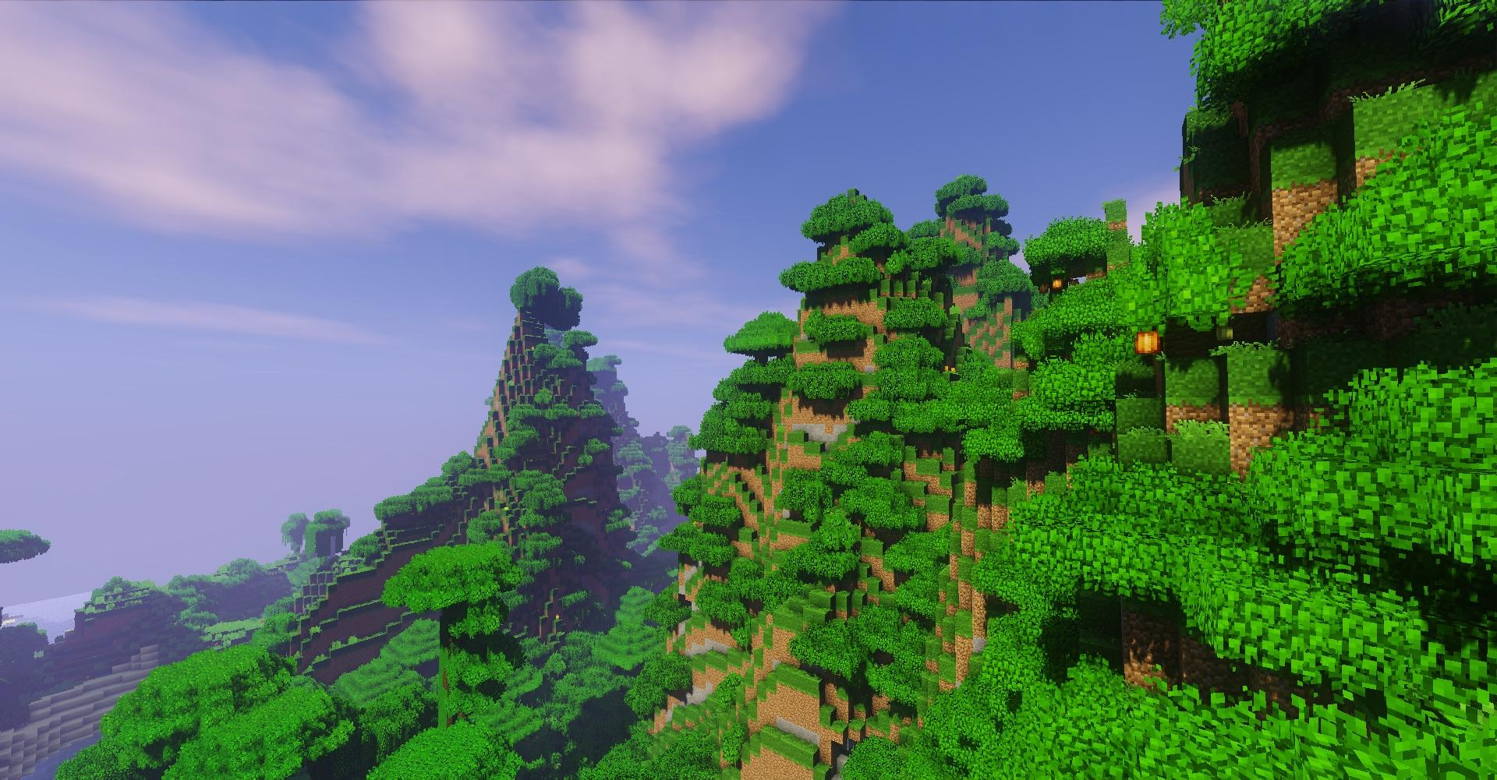
New Generation
Presented by :
Jean-Baptiste GOSSOT, Lead Game Designer
An Project
B-ENG-200

Slide 10
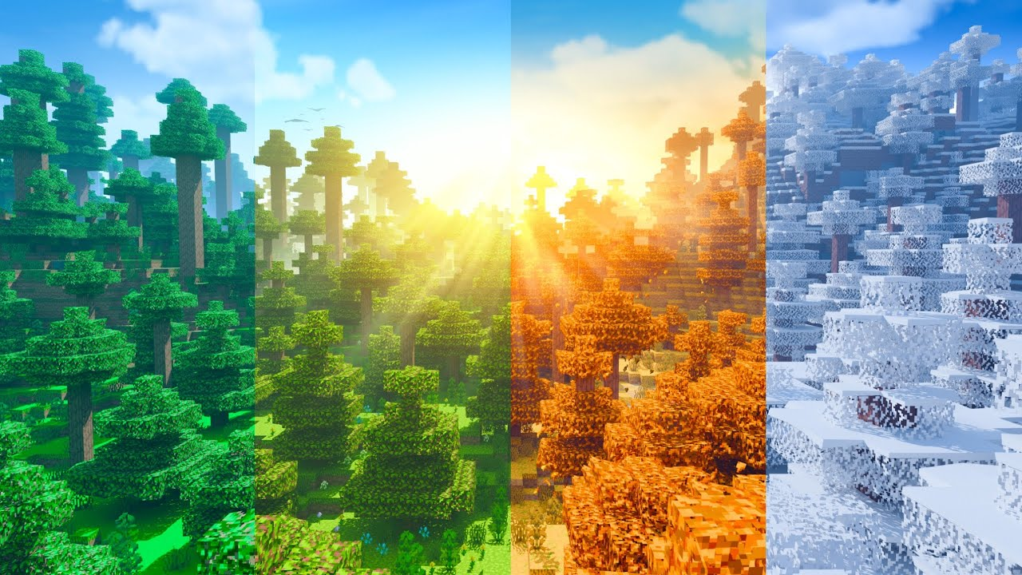
Introducing Seasons and New Mechanics
Presented by :
Jean-Baptiste GOSSOT, Lead Game Designer
An Project
B-ENG-200

Slide 11
Our Inspirations & Game Background :
The Minecraft Community
Mods for Minecraft Java & Datapacks
Cutting edge AI
Creative freedom
Presented by :
Jean-Baptiste GOSSOT, Lead Game Designer
An Project
B-ENG-200

Slide 12
What makes Minecraft 2 Unique :
Unmatching possibilities (Code mechanics, sculpting, etc…)
Next-gen Graphics & Physics : With RT Graphics (Available with compatible graphics card or console)
Day One Cross platform Multiplayer
Native massive multiplayer tool (World Edit like)
Presented by :
Jean-Baptiste GOSSOT, Lead Game Designer
An Project
B-ENG-200

Slide 13
Marketing
Global Marketing Campaign (Youtube, Twitch, Tiktok, etc…)
Early Access & Beta Testing
Cross Platform release
DLC & Mod support
Educational & Enterprise usage
Presented by :
Jean-Baptiste GOSSOT, Lead Game Designer
An Project
B-ENG-200

Slide 14
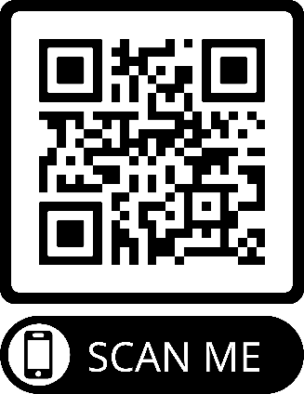
Conclusion
Minecraft 2 : Redefining sandbox gaming
Opportunity to invest in the future of gaming and creativity
Join us to bring Minecraft 2 to the world by scanning the QR Code bellow.
Presented by :
Jean-Baptiste GOSSOT, Lead Game Designer
An Project
B-ENG-200

